Slide 1
Educational Blogging
Michael L. Kelley Jr.
Canon-McMillan School District

Slide 2
Why Blog?
Provide contact, course, and schedule information
Reinforce concepts
Use as a research “notebook”
Post homework/problem sets
Extra credit
Encourage discussion

Slide 3
Where to Blog?
Edublogs > https://edublogs.org/
Weebly > https://education.weebly.com/
Blogger > https://www.blogger.com/home

Slide 4
Blog Examples
Edublogs: http://edutech4teachers.edublogs.org/
Weebly: http://nsis5thgrade.weebly.com/
My Blogger blog: https://abitofabyte.blogspot.com/

Slide 5
Blogger
Quick blog creation
Public or private
Ties into Google account
Fast editing tools(MS Word)
100 blogs per account (different courses)
Team members
Some benefits include:

Slide 6
Blogger Blogging 101
Step 1 (Setup)
Step 2 (Content)
Step 3 (Publish)
Create Blog:
Click > New Blog
Pick a Blog Title
Pick a Web Address
Pick a Template
Click > Create
Content:
Create posts w/ content including:
Text
Audio
Photographs
Video/Youtube
Web Links
Publish & Moderate:
Publish posts to make them viewable on the web.
Monitor comments to promote healthy discussion and maintain an educational atmosphere

Slide 7
Getting Started with Blogger
Google account (CMSD Email Account)
Google Drive https://www.google.com/drive/
(Could also use Dropbox, etc.)
Blog name ( NAME @ blogspot.com )
* A lot of names are already taken

Slide 8
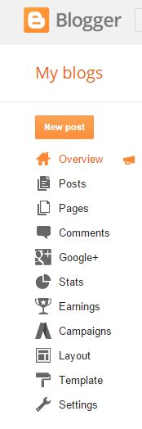
Blogger Dashboard
Menu

Slide 9
Creating a Text Post
The easiest type of post
Like using Microsoft Word, but it has a Publish to the internet button

Slide 10
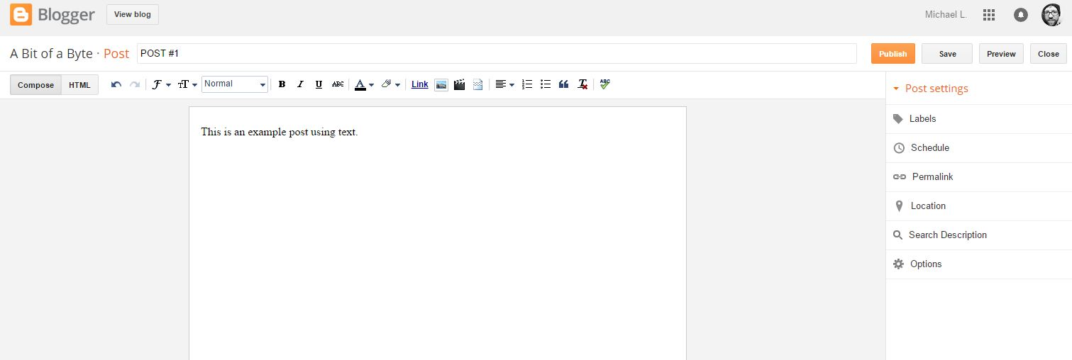
Creating a Text Post

Slide 11
Posting a Photograph
Click > Insert Image Button on toolbar
Browse computer and pick photo to upload
Click > Add Selected
Change size, align, add caption

Slide 12
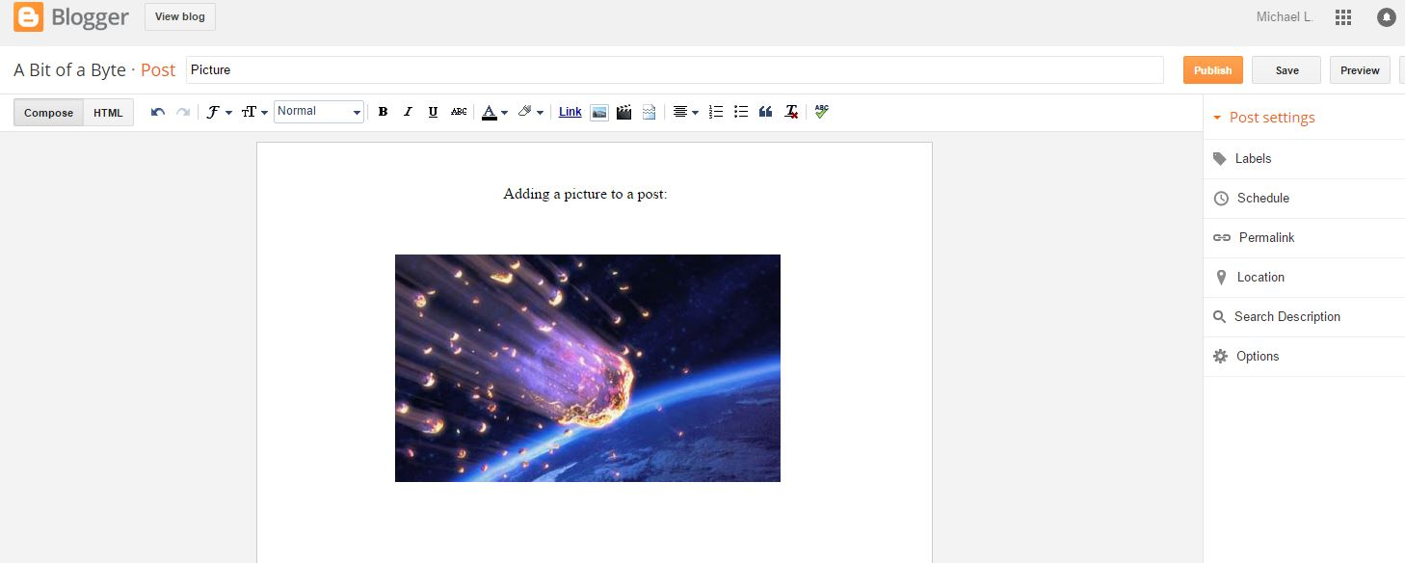

Slide 13
Posting a Video
Pick video from file on computer or from Youtube
Find video on Youtube and copy the link
Paste link in box and click Search. Video should load. Next, click on the video and click Select to insert onto blog

Slide 14
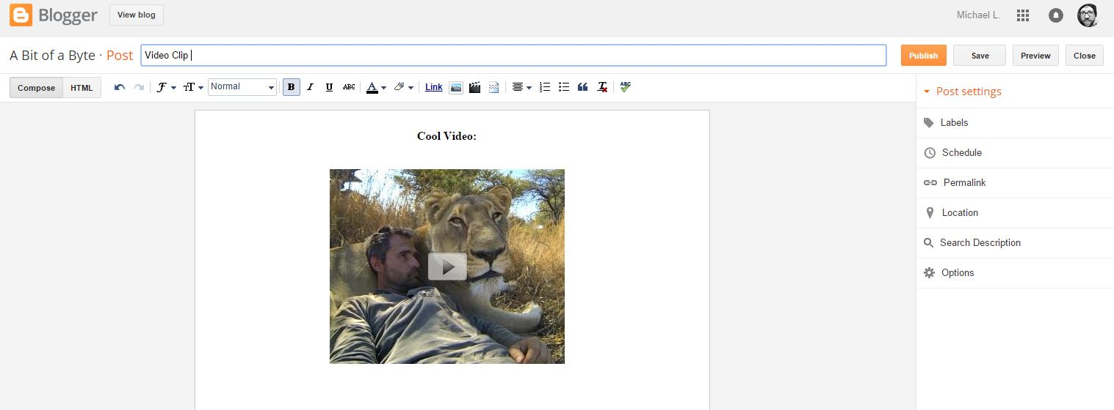

Slide 15
Insert a Web Link
Type the link text out ~ (ex: www.google.com)
Select all of the text in the link
Click the Link button on toolbar
The link is then created and is clickable

Slide 16

Publishing Posts
Posts can be saved for later as a draft (Just like an email draft)
Posts can be previewed (New window)
Advanced post settings include: Labels, Scheduled Post Time, and Location

Slide 17
Labels
Labels help people and computers find your posts
Labels are descriptive words (keywords) that go along with your post content. Not necessary, but helpful
Think of a label as a hashtag on Twitter, but without the #

Slide 18
Other Blogger Functions
Font / Font Size
Text Color / Background Color
Alignment
Numbered List / Bullet List
Quotes
Bold, Italic, Underline, Strikethrough, etc.
Spell Checking
HTML support

Slide 19
Functions Continued
Page Layouts ~ Pick where things are located
Gadgets ~ Already made and extend the functionality of a blog (ex: Polls, Follow buttons)
Templates ~ Change the overall blog design/color scheme

Slide 20
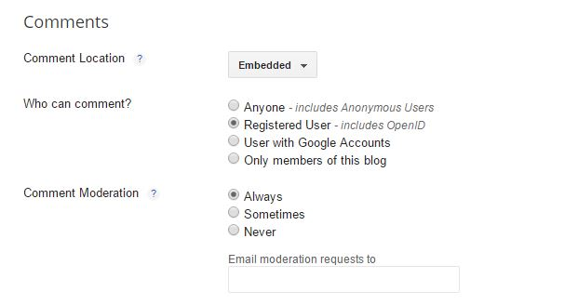
Comment Moderation (Important!)
Dashboard > Settings > Posts and Comments

Slide 21
Link Shortening
Some links can be rather long
Bitly: https://bitly.com/
Google URL Shortener: https://goo.gl/
Use these services to shorten the length of your blog post links and make them easier for people to find

Slide 22
Link Shortening Example
Original Link:
http://abitofabyte.blogspot.com/2014/03/chromium-chrome-os-guide-for-hobbyist.html
Shortened Version:
http://bit.ly/1H06NlL

Slide 23
Advanced Topic ~ Share a File from Google Drive
Files in google drive can be shared publicly and linked to from a blog (ex. worksheet from class)
Files shared this way will generate a link that can be used to give out to people or post a link to
See more on this topic at: https://support.google.com/docs/answer/2494822?hl=en

Slide 24
Resources / Helpful Links
Blogger - Getting Started Guide:
https://support.google.com/blogger/answer/1623800?hl=en
Blogger Privacy Settings (Private, Specific readers, etc): https://support.google.com/blogger/answer/42673?hl=en

Slide 25
Resources / Helpful Links
Blogger Help Center: https://support.google.com/blogger/?hl=en#topic=3339243
Google Drive Share Settings: https://support.google.com/docs/answer/2494886?hl=en
Blogger Comment Moderation: https://support.google.com/blogger/answer/42537?hl=en

Slide 26

CHALLENGE TIME!
Create a blog that has the following:
Blog Title
Text (Coursework, hobby, random text)
1 Video from Youtube
2 Photographs (Give 1 a caption)
Formatting Edits (ex. Text Color, Fonts, Bold)
3 Different Web Links (Sites, Videos, Audio, Documents)
Turn on Comment Moderation to ‘Always’
Once completed, publish post
* Bonus: Share a file from Google Drive and link it on blog

